Slide 1
Welcome to UWE Bristol
Professor Amanda Coffey
Deputy Vice-Chancellor and Provost
January 2022

Slide 2

UWE Bristol transforms futures: powering the future workforce, supporting local economic prosperity, shaping the health and sustainability of our communities and creating solutions to global challenges.

Slide 3
Strategy 2030 Transforming Futures
Our Values
Ambitious
We are not afraid to shape, challenge and tackle the big issues, to take the initiative and pave the way.
Inclusive
We make UWE Bristol a supportive and inspiring place to learn and work – somewhere where diversity of experience and perspective is encouraged, and learning and research is shared and accessible.
Innovative
We create new opportunities for the people who work and study with us. We embrace different ideas and pioneer new and sustainable ways of doing things.
Collaborative
We have strong connections locally and globally. We help people and organisations be the best they can, building trust throughout our university community and beyond.
Enterprising
We instil a thirst for new knowledge, its creation and application, empowering our students and staff to demonstrate a creative questioning approach, a ‘can-do’ confidence, and ability to navigate uncertainty.

Slide 4
Strategy 2030 Transforming Futures
Our Purpose – solving future challenges through outstanding learning, research and a culture of enterprise
Our People – creating opportunities to thrive and flourish
Our Place – creating an inspiring local and global gateway to the future

Slide 5

University Structures – Faculties
Current University Structures – Faculties
Business & Law (FBL)
Bristol Business School; Bristol Law School
Environment & Technology (FET)
Engineering, Design & Mathematics; Architecture & Built Environment, Computer Science & Creative Technologies
Health & Applied Sciences (HAS)
School of Health & Social Wellbeing; Social Sciences; Applied Sciences
Arts, Creative Industries & Education (ACE)
School of Creative and Cultural Industries; School of Art & Design; Education and Childhood
4 Faculties : Business & Law (FBL)
Bristol Business School, Law, Bristol Institute of Legal Practice
Environment & Technology (FET)
Engineering, Design & Mathematics, Architecture & Built Environment, Geography & Environmental Management, Computer Science & Creative Technologies
Health & Applied Sciences (HAS)
Allied Health Professions, Health & Social Sciences, Nursing & Midwifery, Biological, Biomedical Analytical Sciences
Arts, Creative Industries & Education (ACE)
Art & Design, Arts & Cultural Industries, Film & Journalism, Education
Led by Executive Deans/PVCs
Supported by Associate Deans, Academic Directors, Heads of Department

Slide 6
Professional Services
  Centralised support with faculty facing teams Main Contacts :
    Student and Academic Services
      Student Administration Team - assessment, coursework submission, field and award boards, visit arrangements
      Learning & Teaching Enhancement Team – external examining, accreditations, module and programme review, change and approval.
    Library, Careers and Inclusivity
    Library services, reading lists, academic skills support, Peer Assisted Learning, careers and employability services and student research support.
  Centralised support
  Faculty facing
  Main Contacts : Academic Services
    Student Administration Team (papers, boards, visit arrangements)
    Learning & Teaching Enhancement Team – External Examining (contracts, reports)

Slide 7
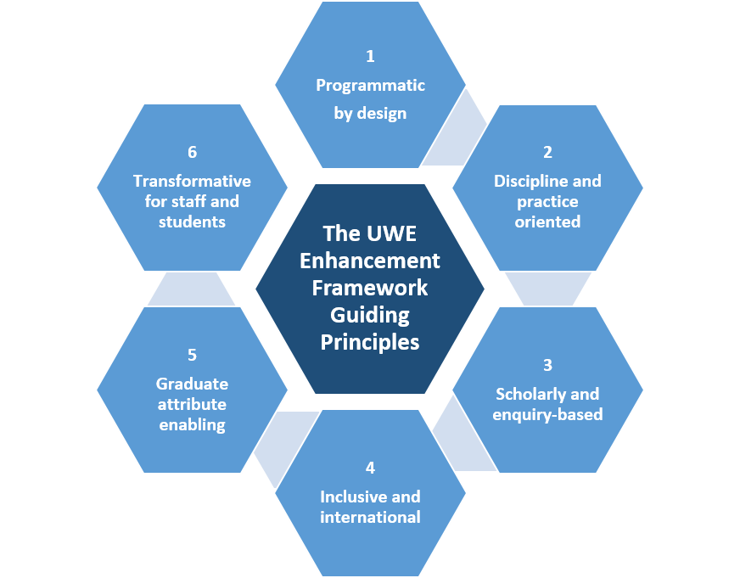
Quality Management & Enhancement Framework (QMEF)
Enhancement Framework
Flexible and strategic risk based approach to developing UWE curriculum
Covers curriculum design, improvement and review
Develops shared understanding of what a UWE Degree “looks like” through shared guiding principles
Supported by a Continuous Improvement Tool: data, reflection, review

Slide 8
Ready and able graduates
Over 7,000 skilled graduates annually; half stay in the South West
Over 400 Applied Scientists
Over 500 Architects and Planners
Over 300 Artists and Designers
Over 1,400 Business, Finance and Economic specialists
Over 300 Computer specialists
Over 300 Engineers
Over 1,400 Health Professionals
Over 400 Law graduates
Over 500 Teachers and Education specialists
Notes:
Data based on 18/19 Graduate Outcome survey – to pick and choose depending on relevance to audience (reflect on breadth of skills or focus on key subjects/STEM)
Consistently high in the employability of our graduates – continue to rise.

